Slide 1

Obesity Level Classification
Bahar Almasi

Slide 2
Project Overview
The goal of this project is to build a machine learning classification model that accurately predicts an individual's level of obesity based on their lifestyle habits, physical measurements, and personal information. By leveraging Azure Machine Learning Studio, a complete pipeline is developed, from data preprocessing to model evaluation, to support this prediction task.
The model classifies individuals into various categories (e.g., Underweight, Normal weight, Overweight, Obese) using a variety of input features such as frequency of physical activity, daily water intake, mode of transportation, and consumption of high-calorie foods.

Slide 3
Benefits of the Project
Real-World Impact: Addresses a major public health concern and can be used in wellness apps, healthcare screenings, or nutritional counseling systems.
Multiclass Classification Challenge: Offers an opportunity to apply and compare different classification algorithms (e.g., Logistic Regression, Random Forest, SVM).
Data Preprocessing Skills: Involves handling categorical variables, normalization, and class balance—essential steps in real-world data science.
Pipeline Automation: Showcases the use of Azure ML Studio’s visual interface for building scalable and reusable ML pipelines.
Interpretability & Evaluation: Enables performance comparison using metrics like Accuracy, Precision, Recall, and Confusion Matrix.

Slide 4
Age Gender
1: Underweight
Age
Gender
Height
Weight
BMI
2: Normal Weight
Features:
Label:
3: Over Weight
4: Obese

Slide 5
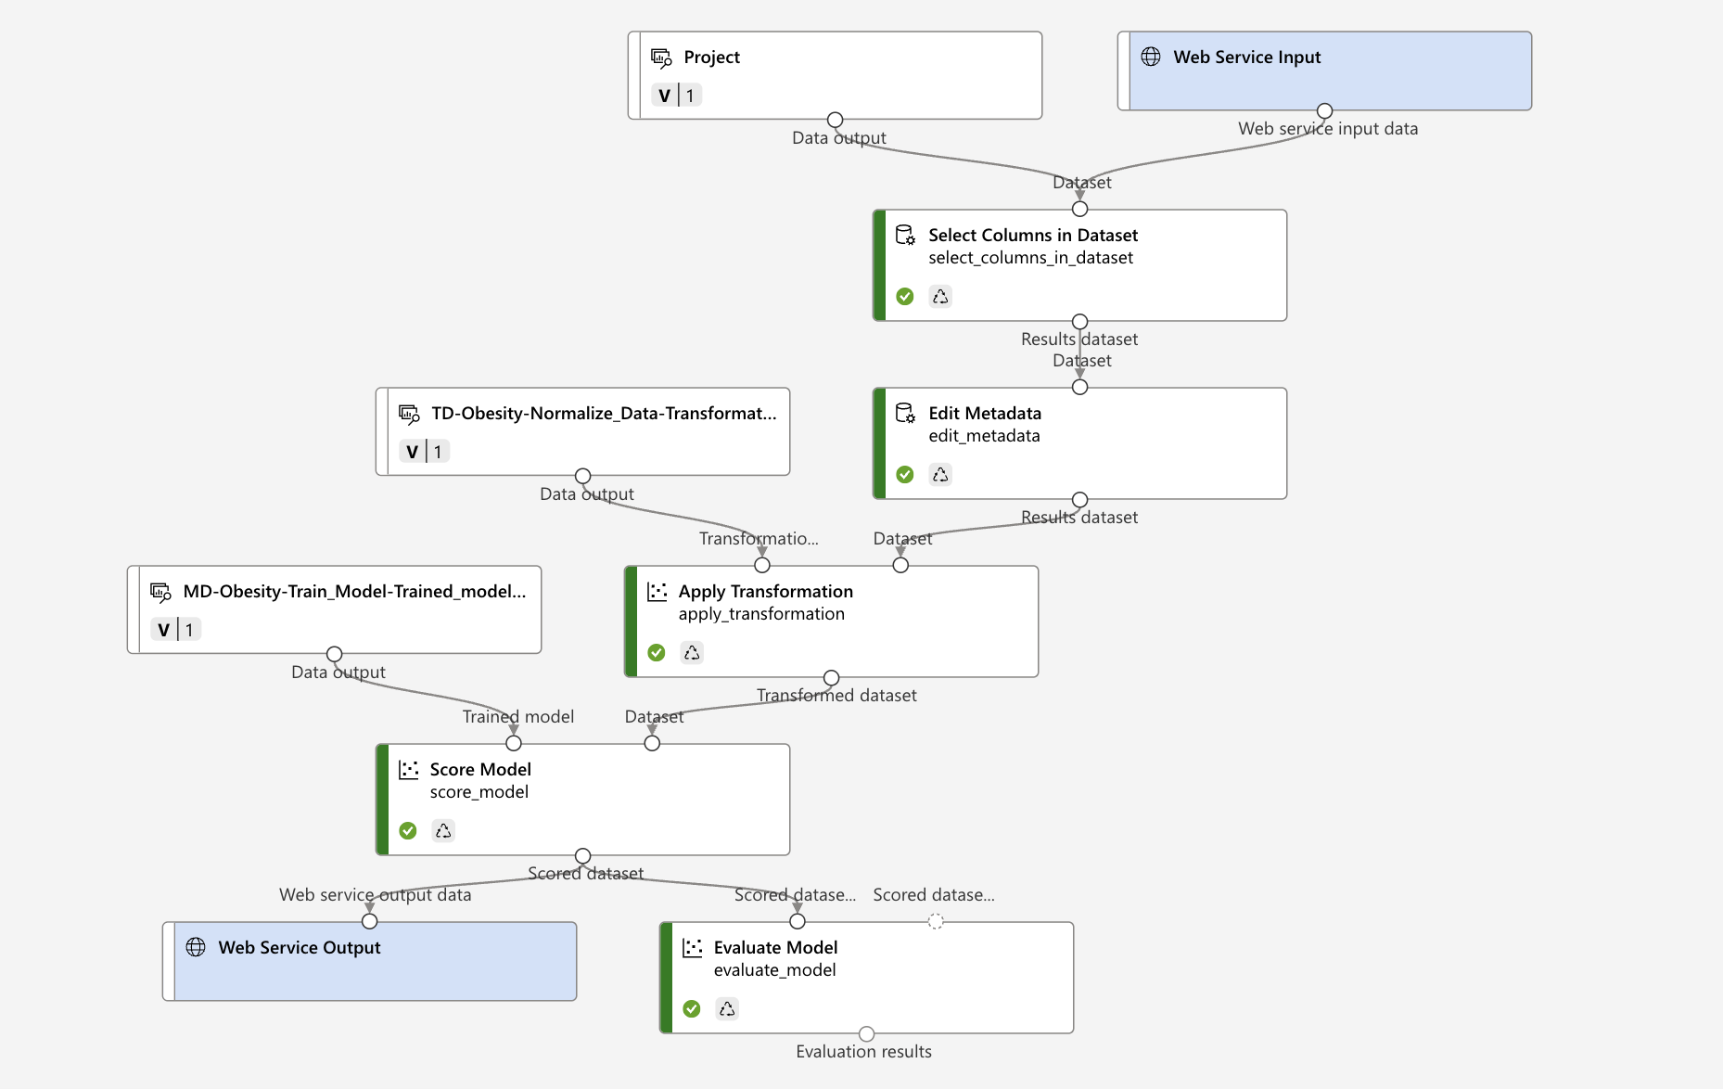
Obesity-real time inference

Slide 6
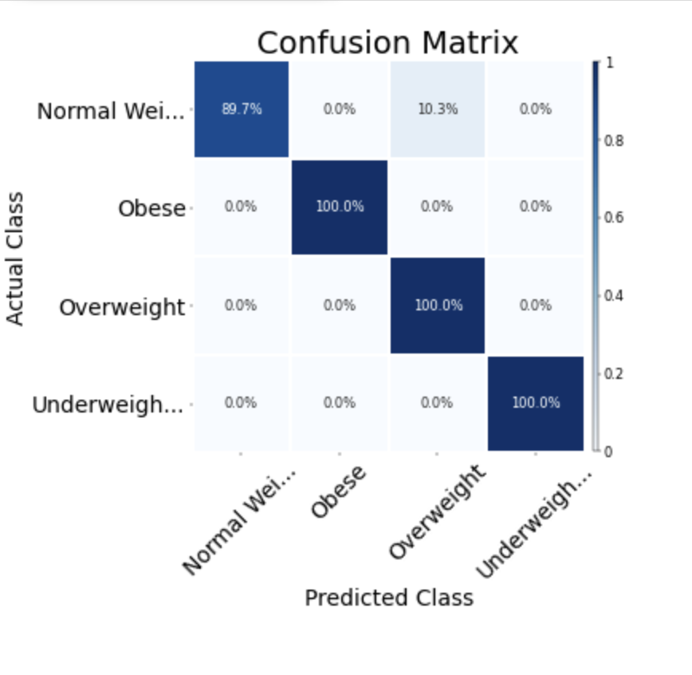
Normal Weight: 89.7% correctly predicted.
Obese, Overweight, Underweight: All 100% correctly predicted — meaning the model
perfectly recognized these three classes.
Only a small portion (10.3%) of Normal Weight individuals were misclassified as Overweight.
📌 Insight: The model performs especially well in detecting more distinct categories like "Obese" and "Underweight", and has only minor confusion between "Normal" and "Overweight" cases — which is common due to close BMI boundaries.

Slide 7
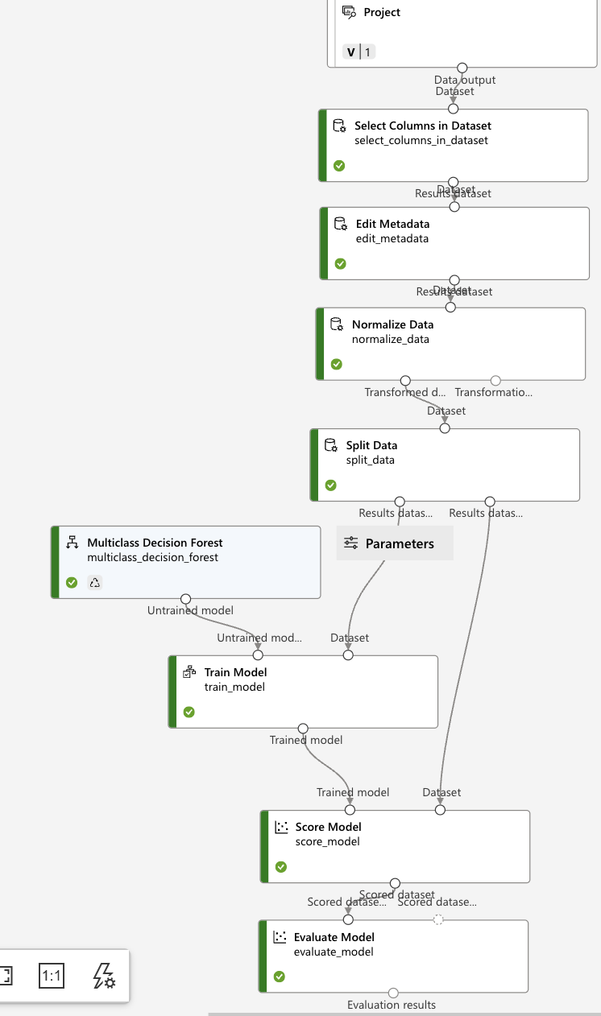
Obesity Classification pipeline

Slide 8
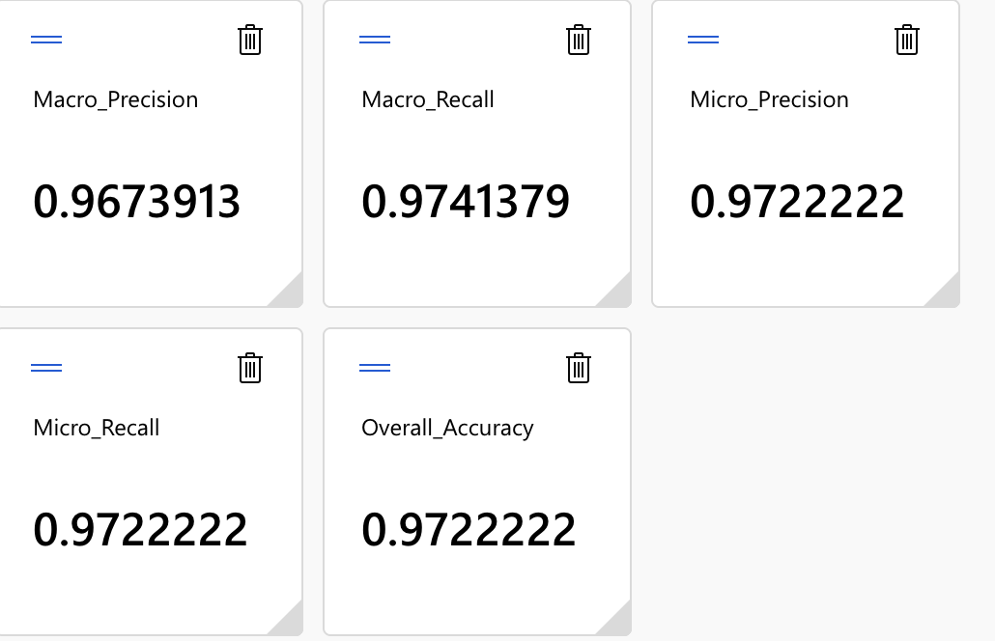
The model performs very well, achieving high precision and recall across all classes. The close values of macro and micro scores indicate balanced performance even in cases of class imbalance.
💡 This means the classifier can reliably identify all weight categories (Underweight, Normal, Overweight, and Obese) with high accuracy and consistency.

Slide 9
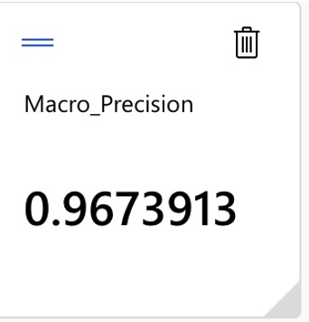
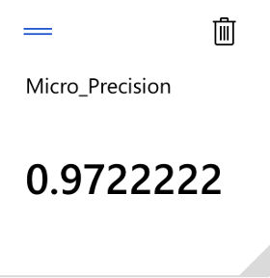

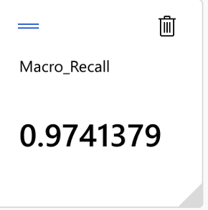
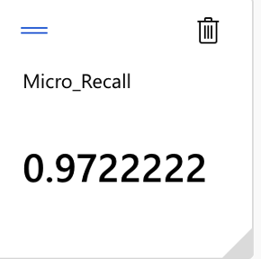
The macro and micro precision values are very close, indicating the model consistently identifies positive cases across both balanced and imbalanced class distributions.
Similarly, the similarity between macro and micro recall suggests that the model effectively detects actual positive instances across all weight categories.

Slide 10
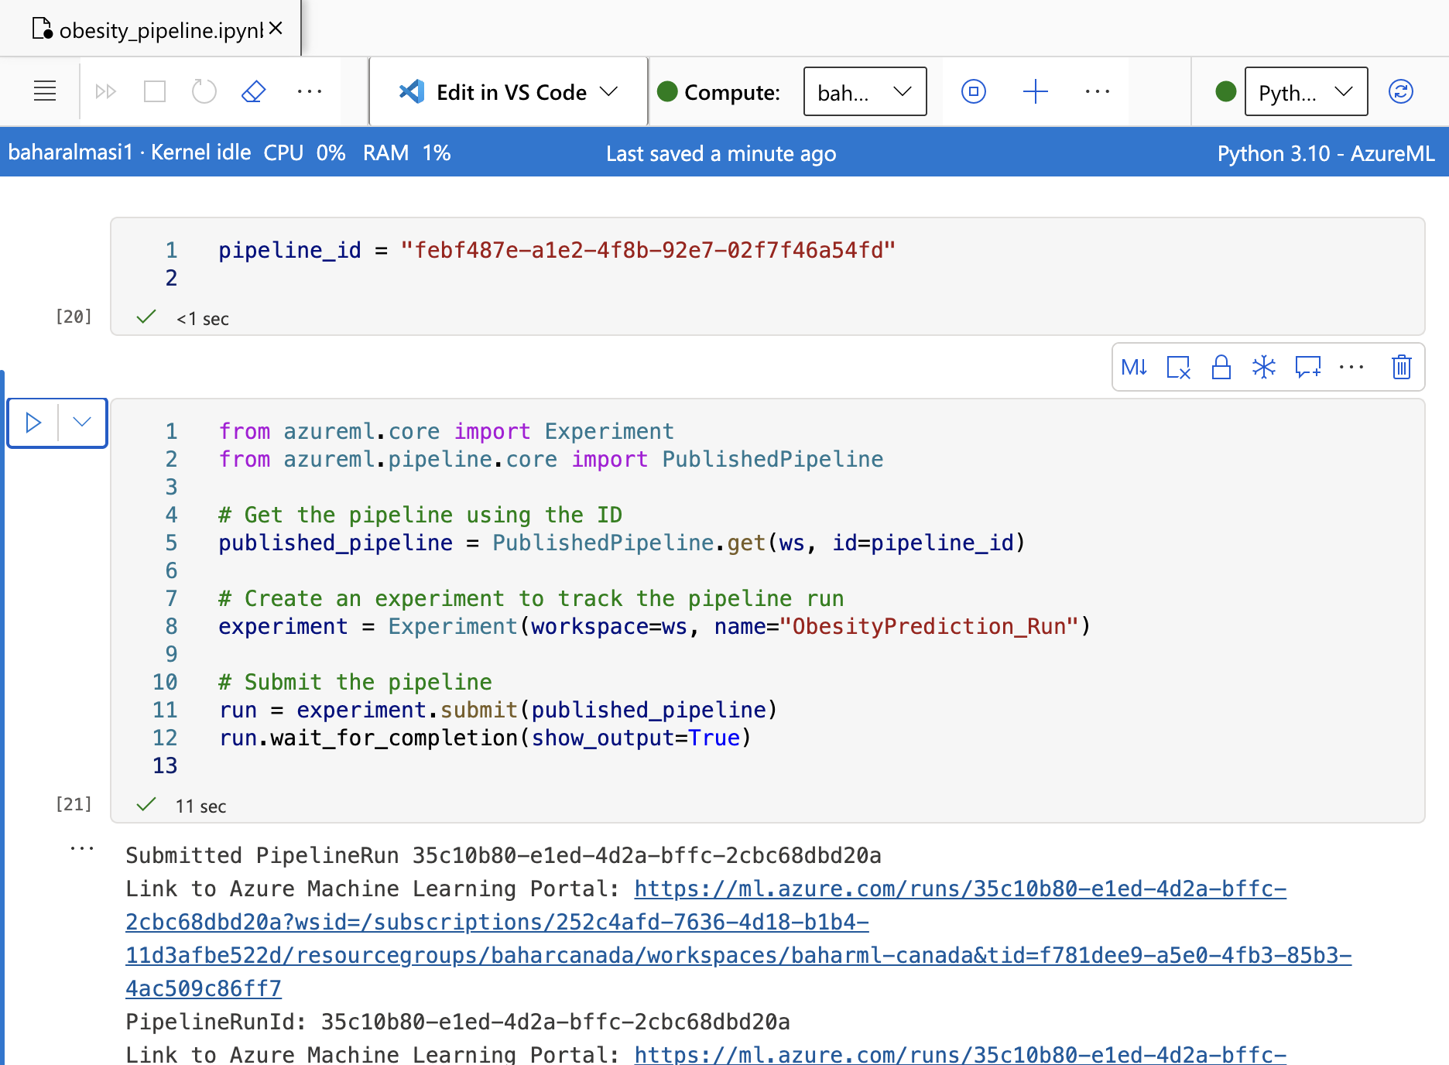
Published pipeline executed successfully using Python and Azure ML SDK.
Submitted under the experiment name ObesityPrediction_Run and completed without errors. Execution confirms the validity of the deployment workflow and demonstrates end-to-end reproducibility of the machine learning solution.

Slide 11
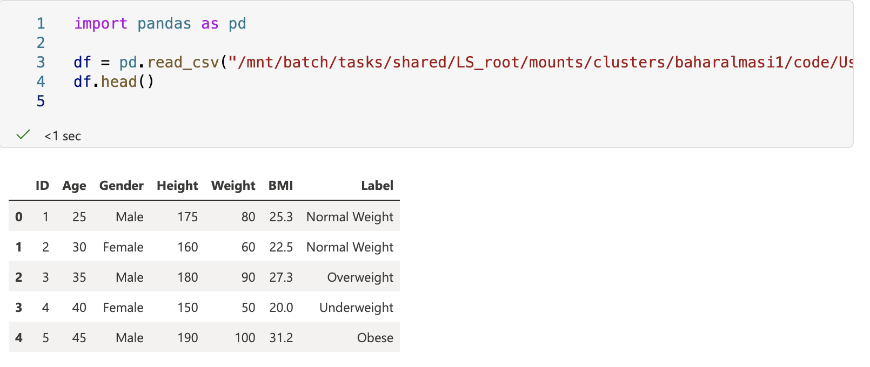

Slide 12
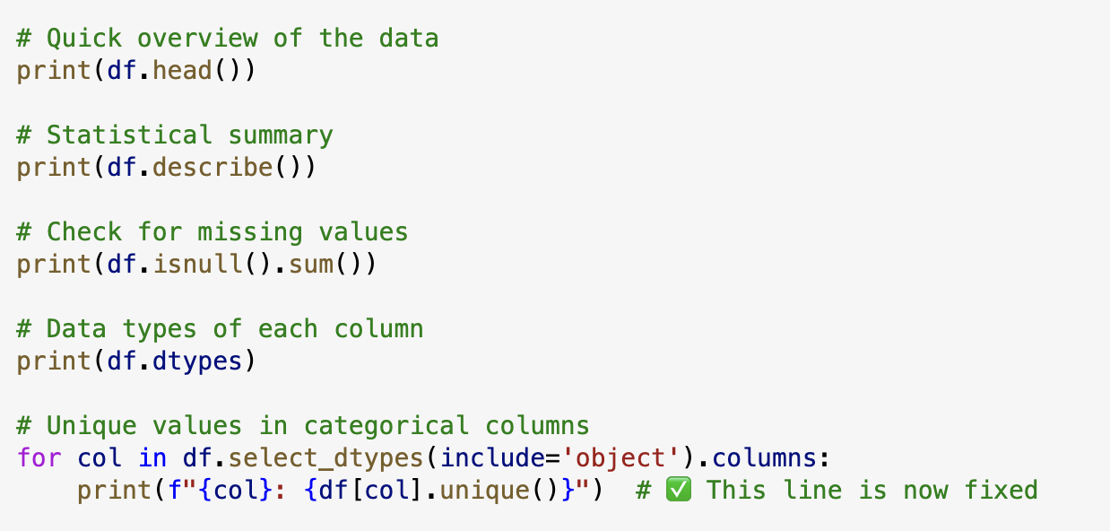
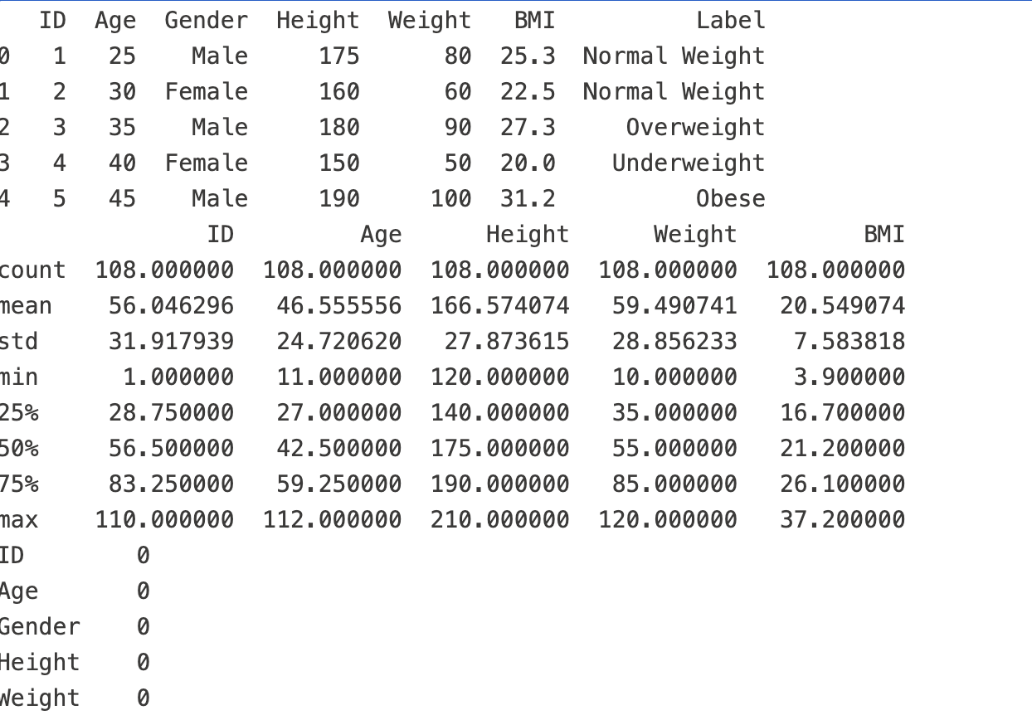
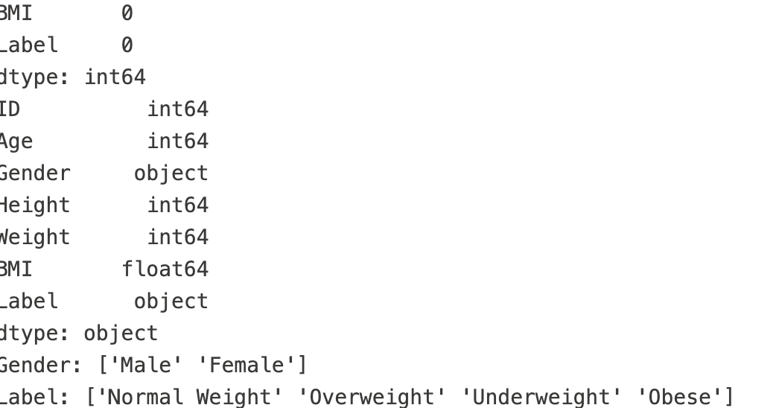

Slide 13
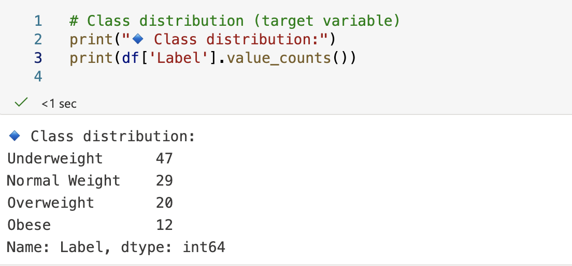

Slide 14
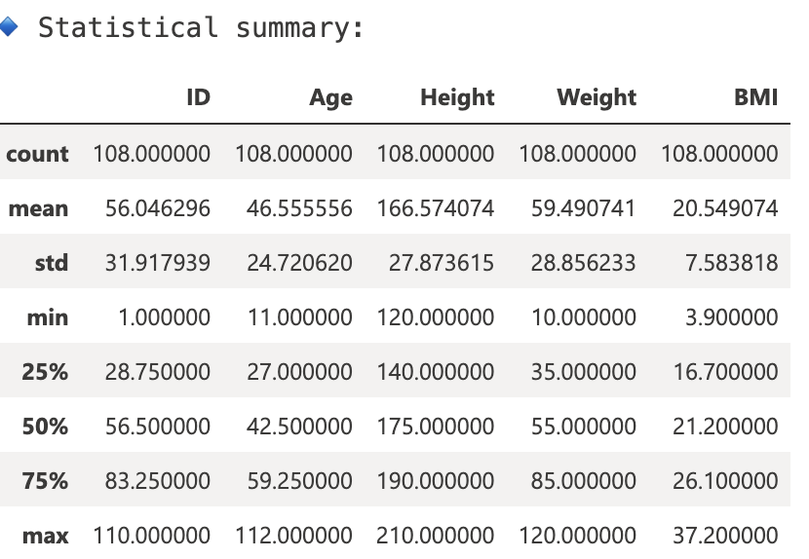
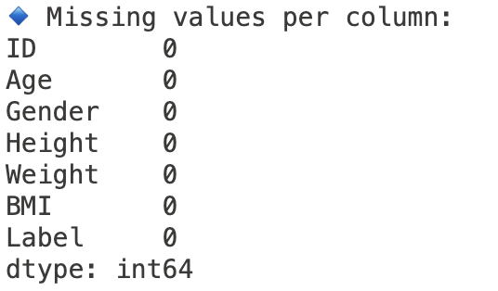
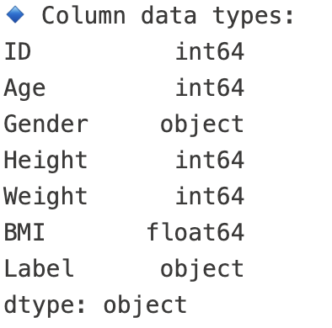
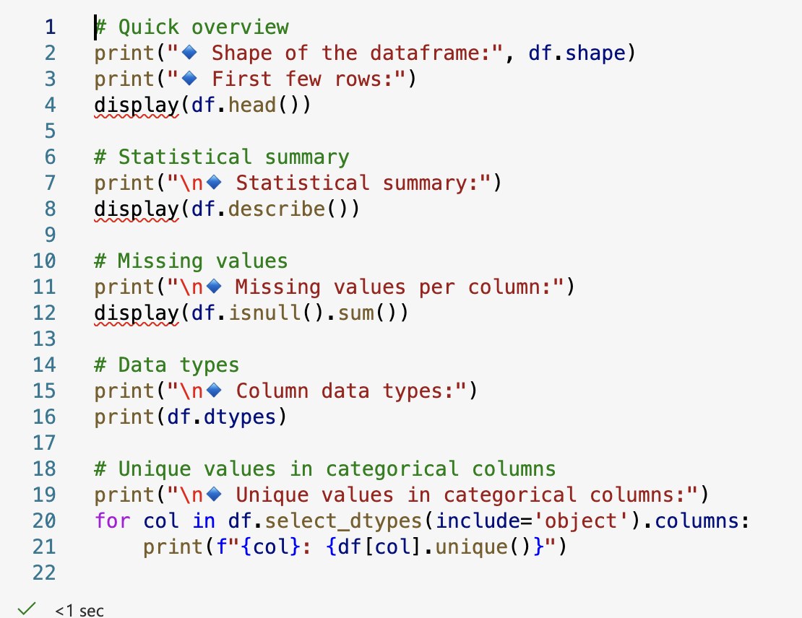
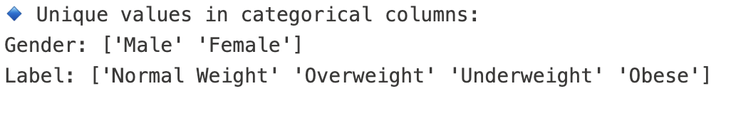

Slide 15
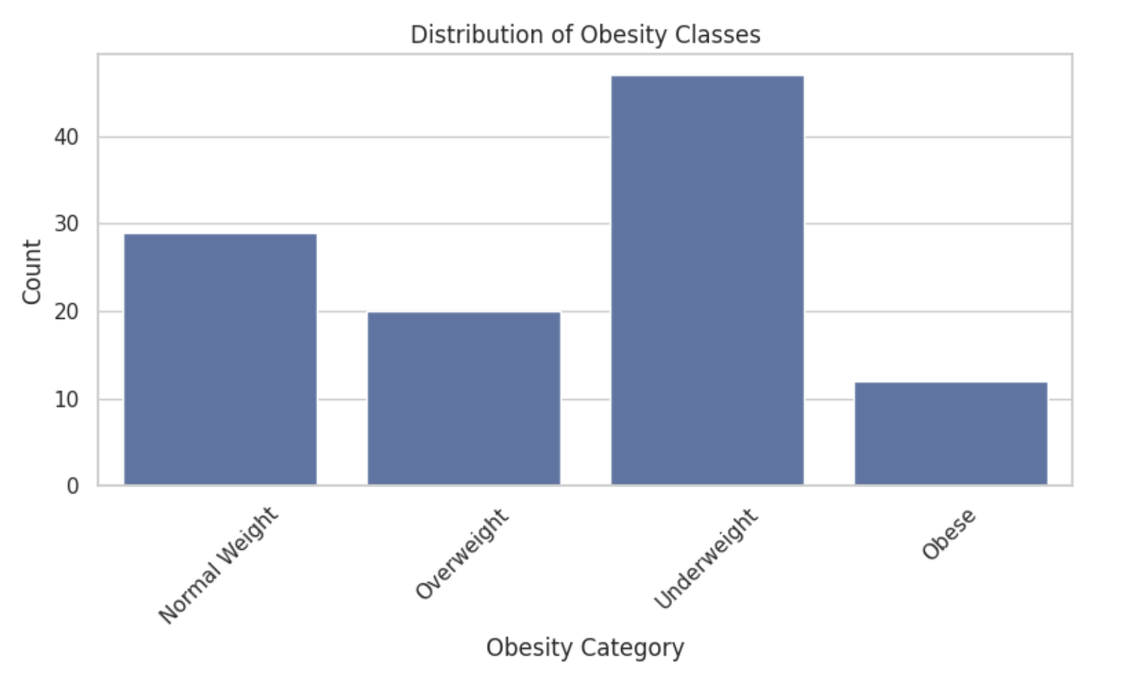
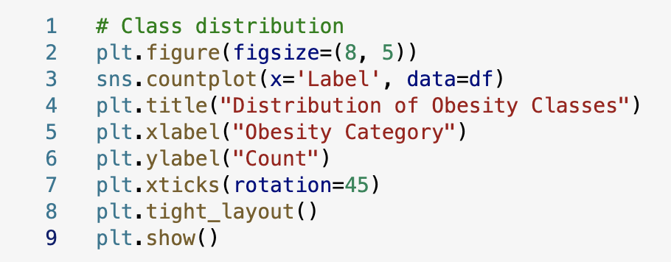

Slide 16
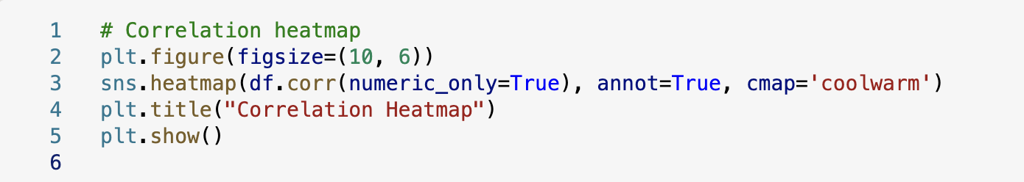
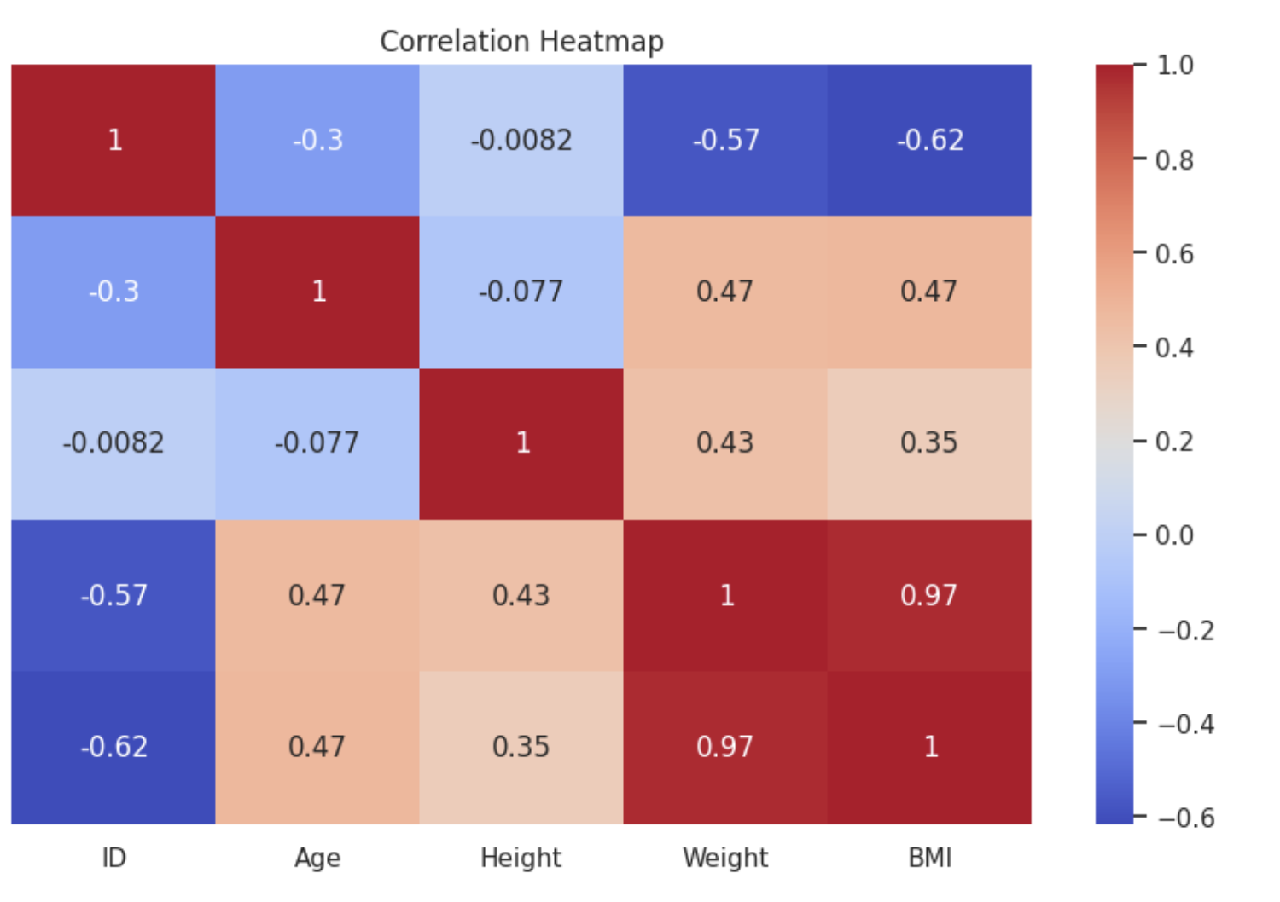

Slide 17
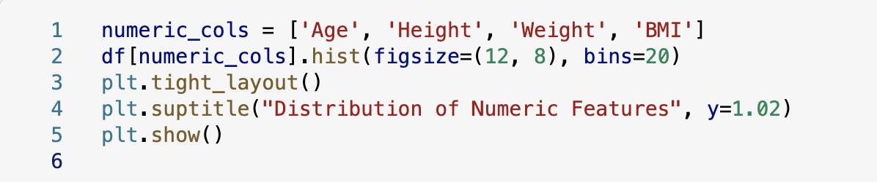
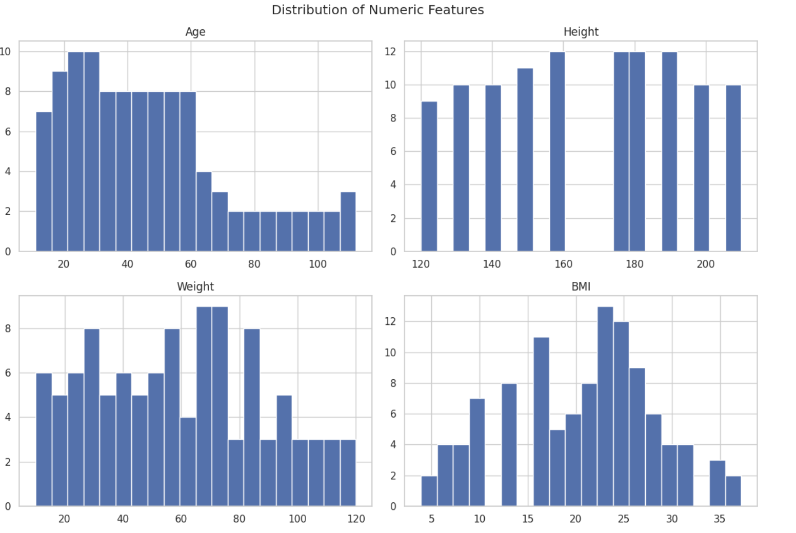

Slide 18
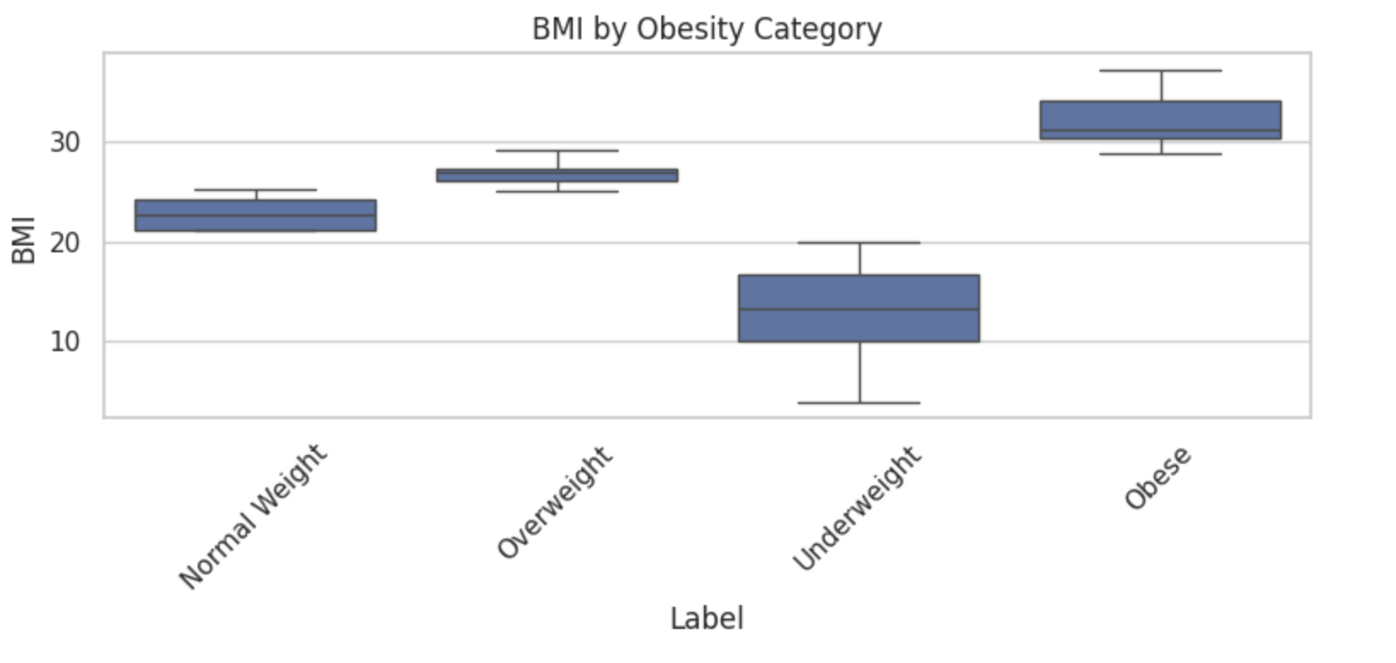
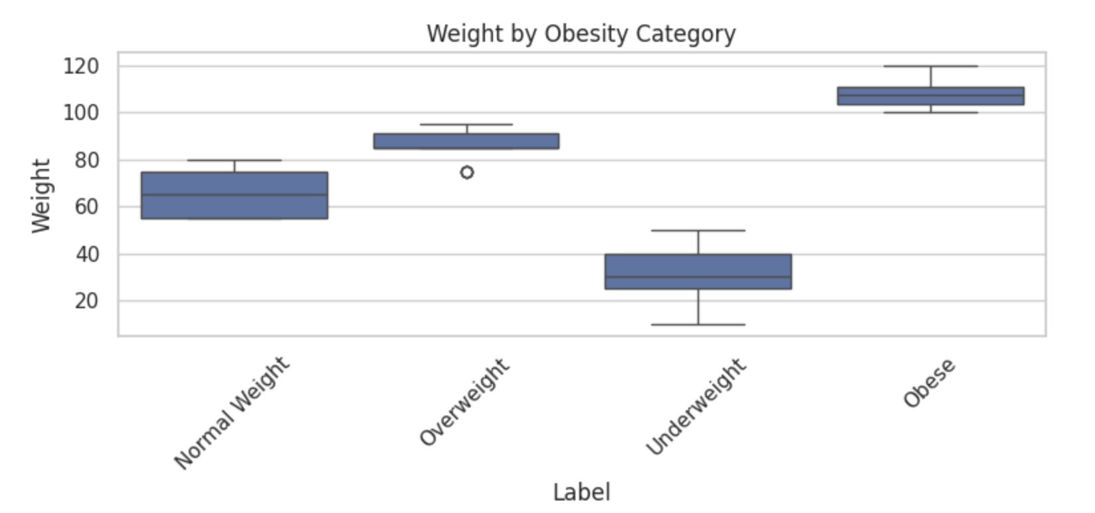
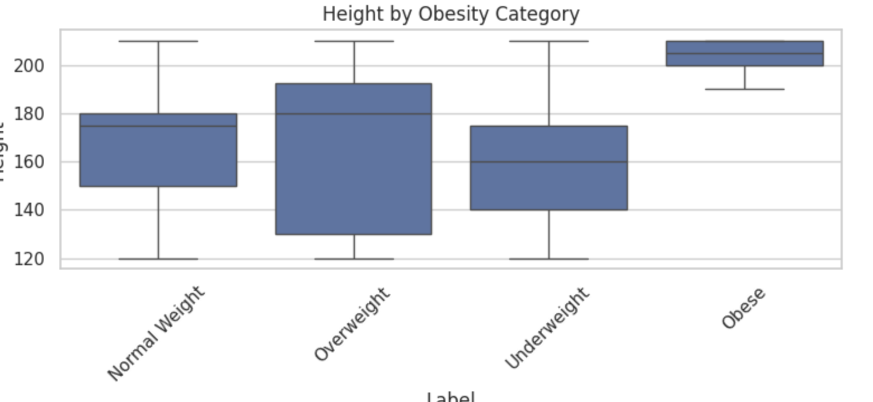
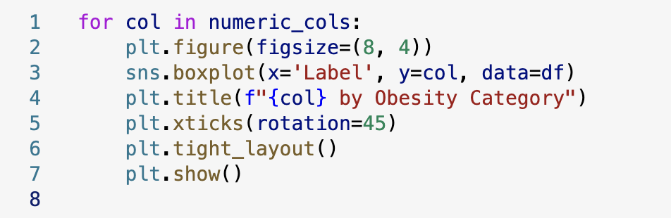

Slide 19
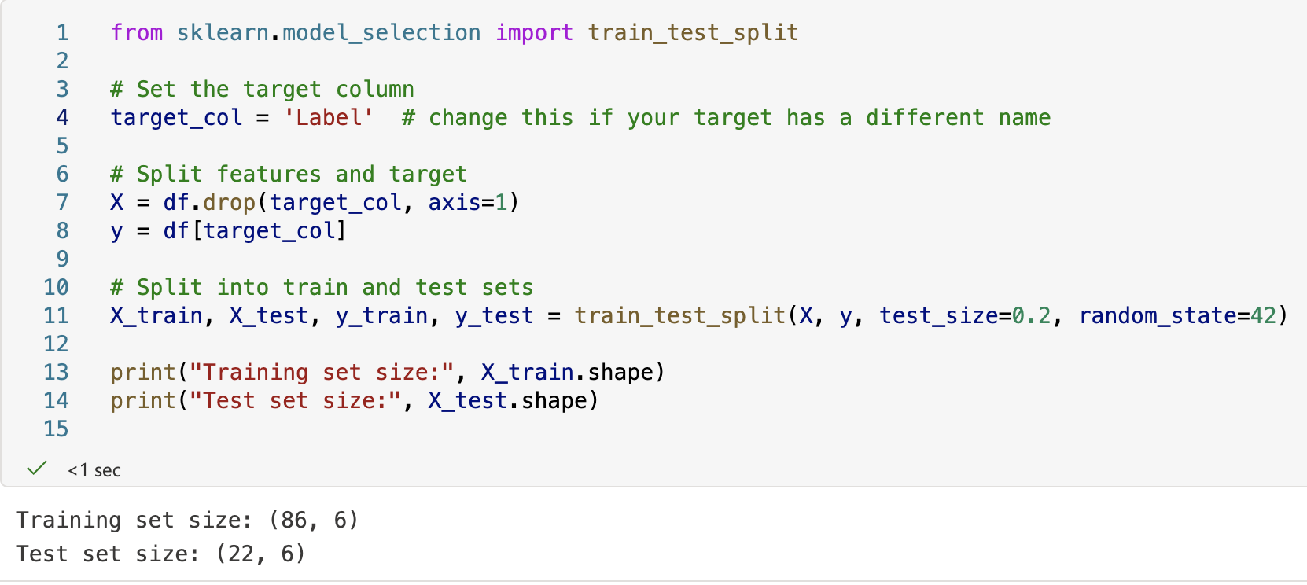
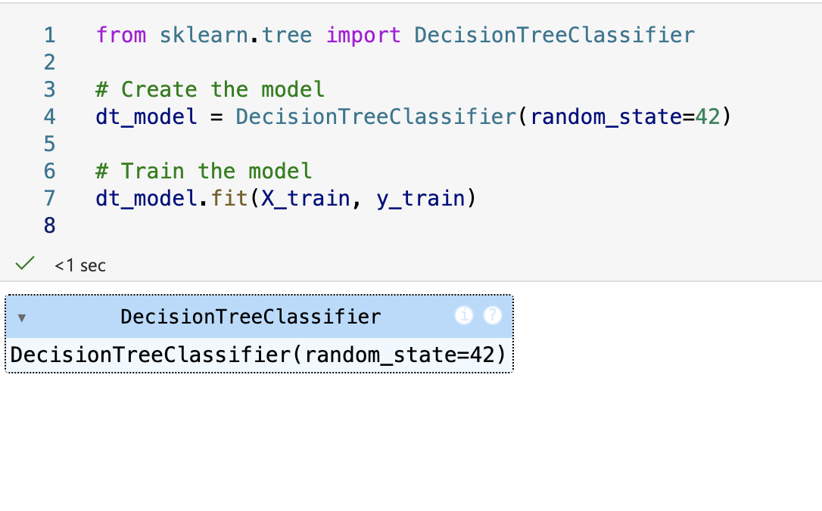
v

Slide 20
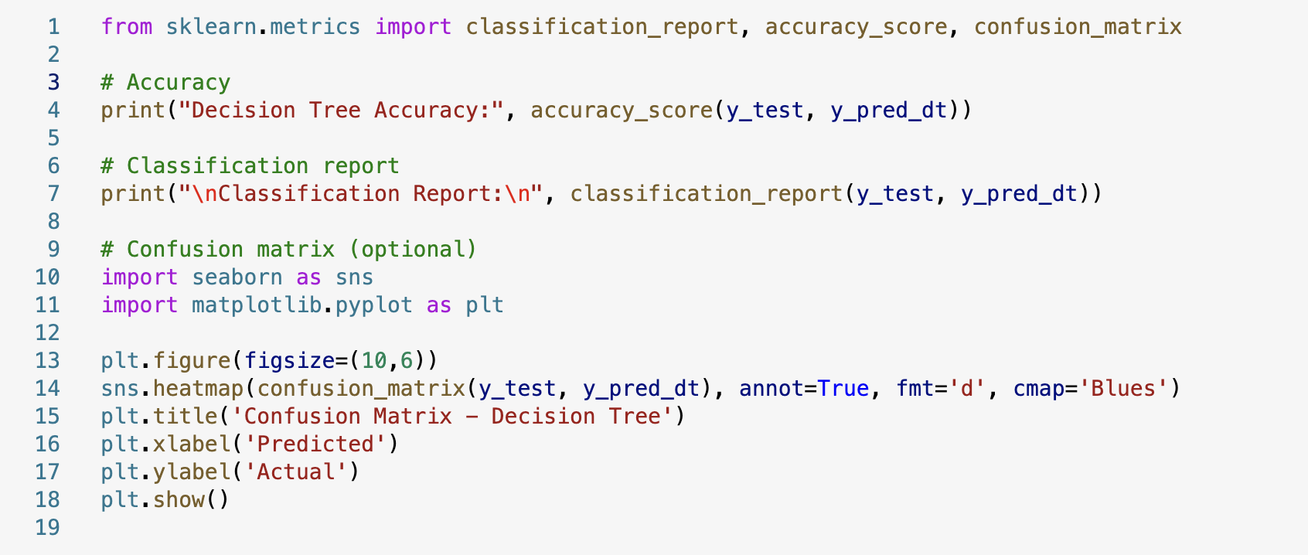
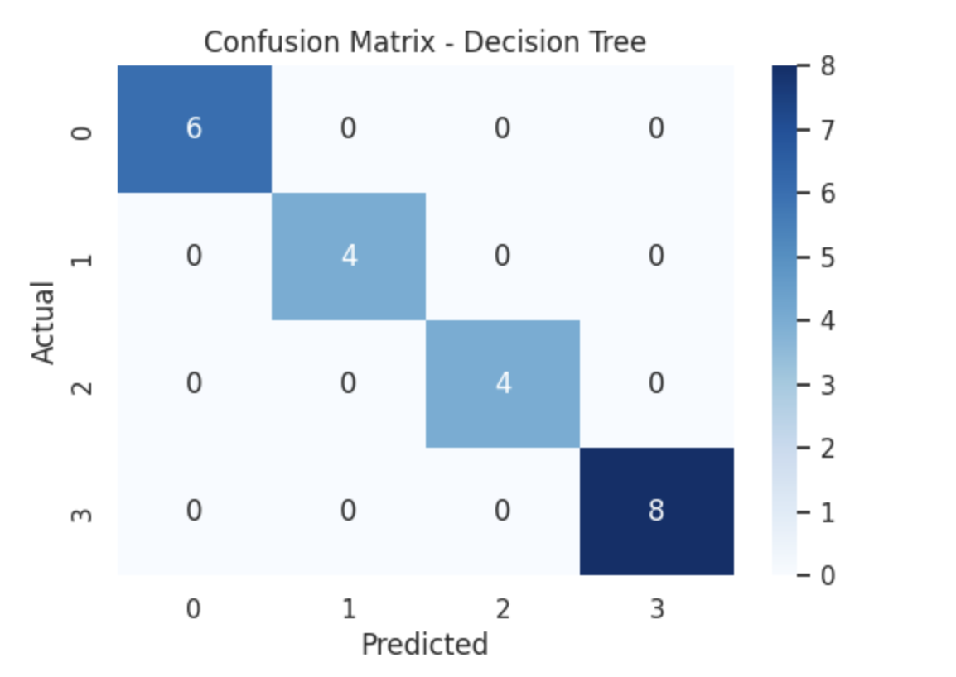
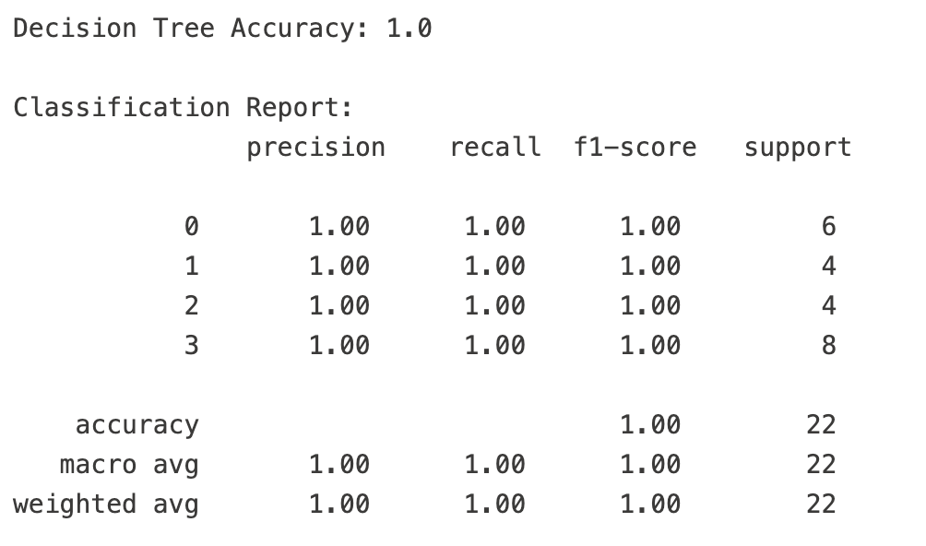

Slide 21
